Slide 1


Noida Institute of Engineering and Technology, Greater Noida
Regular Expressions
Unit: 2
Natural Language Processing
Subject Code: ACSAI0712
Mr. M. Abdul Mateen Siddiqui
(Assistant Professor)
Department of CSE (Cyber Security)
Course Details B. Tech. VII Sem

Slide 2
Faculty Introduction
Name : Mr. M. Abdul Mateen Siddiqui
Qualification: B. Tech (CSE), M. Tech (CSE-CFIS), Ph. D (Pursuing)
Area of Specialization: Cyber Forensics, Information Security, Digital Forensics, Smart Wearable Devices and IoT Devices

Slide 3
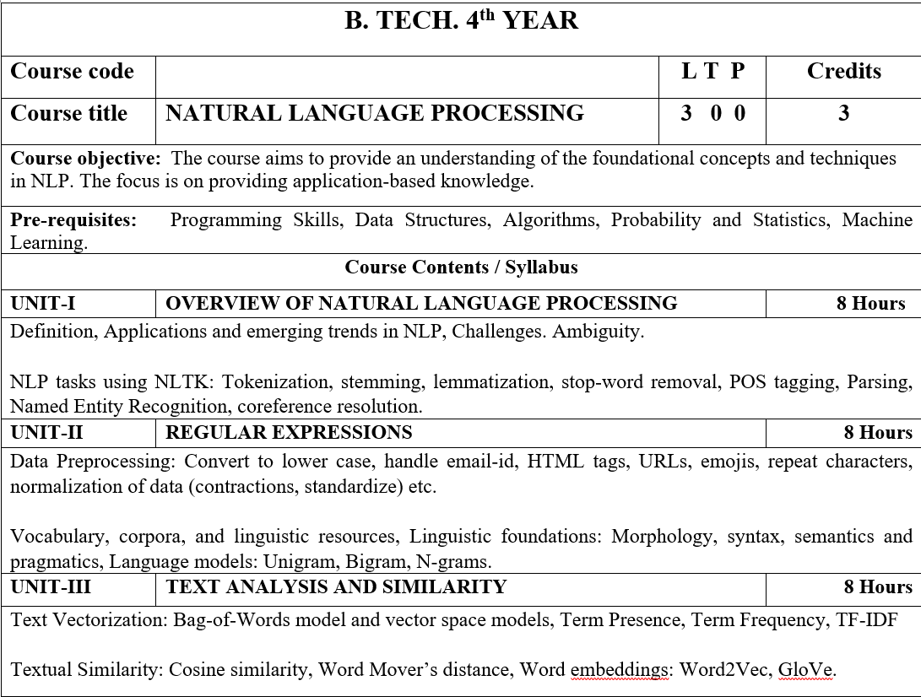
Syllabus

Slide 4
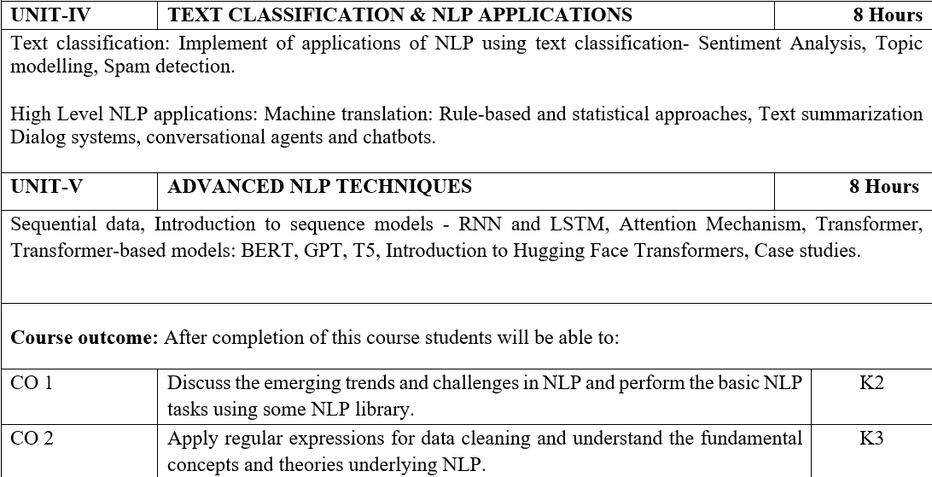
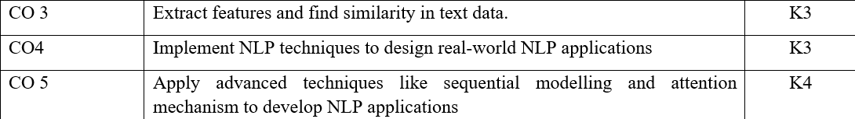
Syllabus

Slide 5
Video Links
https://realpython.com/nltk-nlp-python/
https://www.coursera.org/lecture/python-text-mining/basic-nlp-tasks-with-nltk-KD8uN
https://www.coursera.org/lecture/nlp-sequence-models/learning-word-embeddings-APM5s
https://www.coursera.org/projects/regular-expressions-in-python
https://www.coursera.org/learn/python-text-mining/lecture/sVe8B/regular-expressions

Slide 6
Course Objective
The course aims to provide an understanding of the foundational concepts and techniques in NLP.
The focus is on providing application-based knowledge.

Slide 7
Course Outcome
CO1 | Discuss the emerging trends and challenges in NLP and perform the basic NLP tasks using some NLP library. | K2
CO2 | Apply regular expressions for data cleaning and understand the fundamental concepts and theories underlying NLP. | K3
CO3 | Extract features and find similarity in text data. | K3
CO4 | Implement NLP techniques to design real-world NLP applications | K3
CO5 | Apply advanced techniques like sequential modelling and attention mechanism to develop NLP applications | K4

Slide 8
Program Outcome
1. Engineering knowledge: Apply the knowledge of mathematics, science, engineering fundamentals, and an engineering specialization for the solution of complex engineering problems.
2. Problem analysis: Identify, formulate, research literature, and analyze complex engineering problems reaching substantiated conclusions using first principles of mathematics, natural sciences, and engineering sciences.
3. Design/development of solutions: Design solutions for complex engineering problems and design system components or processes that meet the specified needs with appropriate consideration for public health and safety, and cultural, societal, and environmental considerations.

Slide 9
Program Outcome
4. Conduct investigations of complex problems: Use research based knowledge and research methods including design of experiments, analysis and interpretation of data, and synthesis of information to provide valid conclusions.
5. Modern tool usage: Create, select, and apply appropriate techniques, resources, and modern engineering and IT tools, including prediction and modeling to complex engineering activities, with an understanding of the limitations.
6. The engineer and society: Apply reasoning informed by the contextual knowledge to assess societal, health, safety, legal and cultural issues and the consequent responsibilities relevant to the professional engineering practice.

Slide 10
Program Outcome
7. Environment and sustainability: Understand the impact of the professional engineering solutions in societal and environmental contexts, and demonstrate the knowledge of, and need for sustainable development.
8. Ethics: Apply ethical principles and commit to professional ethics and responsibilities and norms of the engineering practice.
9. Individual and team work: Function effectively as an individual, and as a member or leader in diverse teams, and in multidisciplinary settings.

Slide 11
Program Outcome
10. Communication: Communicate effectively on complex engineering activities with the engineering community and with the society at large, such as, being able to comprehend and write effective reports and design documentation, make effective presentations, and give and receive clear instructions.
11. Project management and finance: Demonstrate knowledge and understanding of the engineering and management principles and apply these to one’s own work, as a member and leader in a team, to manage projects and in multidisciplinary environments.
12.Life-long learning: Recognize the need for, and have the preparation and ability to engage in independent and life-long learning in the broadest context of technological change.

Slide 12
Pre-requisites
Programming Skills,
Data Structures,
Algorithms,
Probability and Statistics,
Machine Learning.

Slide 13
Unit-2:Content
REGULAR EXPRESSIONS:
Data Preprocessing:
Convert to Lower Case
Handle Email-Id
HTML Tags
URLs
Emojis
Repeat Characters
Normalization of Data
Vocabulary
Corpora
Linguistic Resources
Linguistic Foundations:
Morphology
Syntax
Semantics and Pragmatics
Language Models:
Unigram
Bigram
N-Grams

Slide 14
What is Regular Expressions?
Regular Expressions in NLP are powerful and versatile tools for text processing and pattern matching.
A Regular Expression is a sequence of characters that defines a search pattern.
It is used to find, match, or manipulate text based on specific criteria defined by the regular expression pattern.
In NLP, Regular Expressions are commonly used for tasks such as text cleaning, text extraction, tokenization, and pattern recognition.

Slide 15
What is Data Preprocessing?
Data preprocessing in natural language processing (NLP) refers to a series of steps and techniques used to clean, transform, and prepare raw text data for analysis and modeling.
It is a crucial step in the NLP pipeline as it helps ensure the quality and suitability of the data for various NLP tasks and machine learning models.

Slide 16
Main Components involved in Data Preprocessing for NLP:
Text Cleaning
Tokenization
Handling Missing Data
Stop-Word Removal
Stemming & Lemmatization
Removing Duplicates
Text Normalization
Removing Irrelevant Information
Data Splitting

Slide 17
How to converting text to lower case in Data Preprocessing?
Converting text to lowercase in data preprocessing in NLP refers to the process of transforming all the letters in the text to their lowercase forms.
This operation is often performed to ensure uniformity and consistency in the text data and to prevent issues related to case sensitivity during subsequent NLP tasks and analyses.
Here's an example of text before and after converting to lowercase:
Original Text: "The Quick Brown Fox Jumps Over the Lazy Dog."
Text After Lowercasing: "the quick brown fox jumps over the lazy dog."

Slide 18
Handle Email ID in Data Preprocessing
Handling email IDs in data preprocessing in NLP typically involves removing or redacting email addresses from the text data, especially if the email addresses are not relevant to the specific NLP task or could pose privacy or security concerns.
Why Handle Email IDs in Data Preprocessing:
Privacy and Security: Email addresses often contain sensitive or personal information. In many cases, it's essential to protect individuals' privacy by not exposing their email addresses in text data.
Relevance: Email addresses may not be relevant to the NLP task at hand. Including email addresses in text can introduce noise and distract from the primary analysis or modeling objectives.
Normalization: For some NLP tasks, it might be beneficial to replace email addresses with a generic placeholder (e.g., " [email protected]") to standardize the data, especially if email addresses are considered as stop words or uninformative tokens.

Slide 19
How to Handle Email IDs in Data Preprocessing?
Removal: The simplest approach is to remove email addresses entirely from the text data. This can be achieved using regular expressions or pattern matching to identify and replace email addresses with an empty string.
Redaction: Instead of completely removing email addresses, you can replace them with a generic placeholder or label, such as " [email protected]" or "EMAIL." This helps maintain the text's structure while obscuring sensitive information.
Masking: Another option is to mask email addresses by replacing some characters with placeholders, such as replacing characters in the domain part of the email address with asterisks (e.g., " [email protected]" becomes " [email protected]***.com"). This approach can partially hide email addresses while retaining some information.
Custom Handling: Depending on the specific requirements of your NLP task and the nature of the text data, you may choose a custom approach for handling email addresses. For example, you might replace them with a consistent token or code.

Slide 20
Why & How HTML Tags are handled in Data Preprocessing?
In data preprocessing for natural language processing (NLP), handling HTML tags refers to the process of removing or extracting HTML markup and tags from text data.
HTML (Hypertext Markup Language) tags are used to structure and format content on web pages, but they are typically irrelevant to the actual text analysis or NLP tasks.
Why Handle HTML Tags in Data Preprocessing:
Noise Reduction: HTML tags are not part of the natural language content and can introduce noise into text data. Removing them helps focus on the textual content itself.
Text Extraction: In web scraping or data collection from web pages, you often need to extract the meaningful textual content from the HTML structure. Removing tags is a crucial step to obtain the clean text.
Uniform Text: HTML tags can disrupt the uniformity of text data. By removing them, you standardize the text, making it consistent and easier to analyze.

Slide 21
Why & How HTML Tags are handled in Data Preprocessing?
How to Handle HTML Tags in Data Preprocessing:
Stripping Tags: The most common approach is to completely remove HTML tags from the text data. This can be achieved using libraries or regular expressions to identify and replace HTML tags and their content with empty strings.
Text Extraction: In some cases, you might want to preserve the textual content within HTML tags while removing the tags themselves. This can be done by using HTML parsing libraries like Beautiful Soup in Python to extract the text content within specific HTML elements or tags.
HTML Entity Conversion: HTML entities, such as "&" for "&" or "<" for "<," represent special characters in HTML. In data preprocessing, it's common to convert these entities back to their corresponding characters to ensure text consistency and readability.
Here's an example of text before and after handling HTML tags:
Original Text: <p>This is an <b>example</b> of text with HTML tags.</p>
Text After Handling HTML Tags : This is an example of text with HTML tags.

Slide 22
Why & How URLs are typically handled in Data Preprocessing?
Handling URLs in data preprocessing for natural language processing (NLP) refers to the process of managing or removing Uniform Resource Locators (URLs) from text data.
URLs are web addresses that point to specific web pages, documents, or resources on the internet.
In NLP, URLs are often irrelevant to the analysis or modeling tasks and can be treated as noise.
Therefore, it is common to preprocess text data by either removing URLs or replacing them with a generic placeholder.
Here's why and how URLs are typically handled in data preprocessing for NLP:
Why Handle URLs in Data Preprocessing:
Irrelevance: URLs often contain information about web locations, links, or identifiers that may not contribute to the semantic content or meaning of the text for many NLP tasks.
Noise Reduction: Removing or replacing URLs helps reduce noise in the text data, making it cleaner and more focused on the linguistic content.
Normalization: Replacing URLs with a consistent placeholder (e.g., "URL" or " [URL]") can standardize the data and make it more amenable to analysis or modeling.

Slide 23
Why & How URLs are typically handled in Data Preprocessing?
How to Handle URLs in Data Preprocessing:
URL Removal: The most straightforward approach is to completely remove URLs from the text data. This can be accomplished using regular expressions or string matching to identify and replace URLs with an empty string.
URL Redaction: Instead of removing URLs entirely, you can replace them with a generic placeholder or label, such as "URL" or " [URL]." This helps maintain the text's structure while obscuring the specific URL information.
Here's an example of text before and after handling URLs:
Original Text: "For more information, visit https://www.example.com/."
Text After Handling URL (Redaction): "For more information, visit [URL]."
Text After Handling URL (Removal): "For more information, visit."

Slide 24
Why & How Handle Emojis in Data Preprocessing?
Emojis are graphical symbols or icons used to represent emotions, objects, concepts, or other elements in digital communication, such as text messages, social media posts, and online chats.
In data preprocessing for natural language processing (NLP), handling emojis refers to the process of managing, removing, or encoding emojis within text data.
Why Handle Emojis in Data Preprocessing:
Irrelevance: Emojis are often non-textual elements that may not be directly relevant to many NLP tasks. For tasks focused on textual content analysis, emojis can introduce noise.
Standardization: For some NLP tasks, it may be essential to standardize emojis by encoding them as representations. This can be helpful for sentiment analysis or emotion detection tasks, where emojis serve as emotional indicators.
Noise Reduction: In tasks where emojis are considered noise or distracting, they may be removed or replaced with appropriate placeholders.

Slide 25
Why & How Handle Emojis in Data Preprocessing?
How to Handle Emojis in Data Preprocessing:
Removal: The simplest approach is to remove emojis from text data entirely. This can be achieved using regular expressions or pattern matching to identify and replace emojis with an empty string or a specific token.
Redaction or Encoding: Emojis can be replaced with text labels or encoded representations that convey their meaning. For example, the 😀 emoji could be replaced with "happy" or a corresponding sentiment score.
Preservation: In some cases, emojis may be valuable for the analysis, such as sentiment analysis or emotion detection. In such cases, preserving emojis as part of the text data is essential.
Here's an example of text before and after handling emojis:
Original Text: "I'm so excited for the party tonight! 🎉🥳"
Text After Handling Emojis (Removal): "I'm so excited for the party tonight!"
Text After Handling Emojis (Redaction/Encoding): "I'm so excited for the party tonight! [happy face]"

Slide 26
Why & How handle repeat characters in Data Preprocessing?
Handling repeat characters in data preprocessing for natural language processing (NLP) involves addressing instances where characters within words or phrases are repeated multiple times.
This repetition of characters is often considered noise in text data and may not carry significant meaning for many NLP tasks.
Therefore, it is common to preprocess text data by reducing or normalizing repeated characters.
Why Handle Repeat Characters in Data Preprocessing:
Irrelevance: Repeated characters within words or phrases are often non-standard and may not be relevant to the semantic content or meaning of the text for many NLP tasks.
Noise Reduction: Reducing or normalizing repeat characters helps reduce noise in the text data, making it cleaner and more suitable for analysis or modeling.
Normalization: Standardizing text data by eliminating or reducing repeat characters can make it more consistent and amenable to text processing.

Slide 27
Why & How handle repeat characters in Data Preprocessing?
How to Handle Repeat Characters in Data Preprocessing:
Character Reduction: One common approach is to reduce repeated characters to a single occurrence. For example:
"loooove" → "love"
"cooool" → "cool"
Threshold-Based Reduction: You can set a threshold (e.g., three consecutive occurrences) and reduce repeat characters exceeding that threshold. For example:
"loooove" → "loove"
"cooool" → "cool"
Here's an example of text before and after handling repeat characters:
Original Text: "I loooove the movie!!! Sooo cooool!"
Text After Handling Repeat Characters (Character Reduction): "I love the movie! So cool!"
Text After Handling Repeat Characters (Threshold-Based Reduction): "I loove the movie!!! So cool!"

Slide 28
What is Normalization of Data in Data Preprocessing?
Normalization of data in data preprocessing for natural language processing (NLP) involves transforming text data to a standardized format or representation to facilitate more effective analysis, modeling, and text processing.
Normalization is an essential step in data preprocessing, as it helps ensure that the text data is consistent, uniform, and ready for further NLP tasks.
Why Normalize Data in NLP:
Consistency: Normalization ensures that text data follows consistent rules, making it easier to compare and analyze. It helps reduce variations caused by factors like capitalization, punctuation, or character encoding.
Text Standardization: Different documents or sources may use varying conventions for representing dates, numbers, and abbreviations. Normalization standardizes these representations for consistency.
Noise Reduction: Normalization can remove noise or irrelevant information from the text, such as HTML tags, URLs, or special characters.
Facilitating Analysis: Normalized text data is often easier to work with for various NLP tasks, including text classification, sentiment analysis, information retrieval, and machine translation.

Slide 29
Normalization of Data in Data Preprocessing?
Common Techniques for Data Normalization in NLP:
Converting to Lowercase: One of the most basic normalization techniques is converting all text to lowercase. This ensures case insensitivity and reduces vocabulary size.
Removing Punctuation: Stripping punctuation marks (e.g., periods, commas, and hyphens) from text can help focus on the words themselves.
Tokenization: Tokenization splits text into smaller units (tokens), such as words or subword units. This segmentation allows for further analysis at the token level.
Lemmatization and Stemming: Reducing words to their base or root forms using techniques like lemmatization and stemming can normalize text and group related words.
Stop-word Removal: Removing common words (stop words) like "the," "is," and "and" can help reduce noise and focus on content words.
Numeric and Date Normalization: Standardizing the format of numbers, dates, and times to a common representation can ensure consistent handling.
HTML Tag Removal: Eliminating HTML tags and content within tags from web text can be important for text extracted from web pages.
URL Handling: Replacing or removing URLs in text data to eliminate irrelevant web addresses.
Handling Emojis: Converting emojis to appropriate text labels or representations for sentiment analysis or emotion detection tasks.
Handling Repeat Characters: Reducing or normalizing repeated characters within words to eliminate non-standard representations.
Entity Normalization: Standardizing the representation of named entities (e.g., replacing "U.S.A." with "United States of America").

Slide 30
What is Vocabulary in Data Preprocessing?
In natural language processing (NLP), the term "vocabulary" refers to the set of all unique words or terms that appear in a given text corpus or dataset.
It represents the complete inventory of words, phrases, or tokens that are used to express language in the text data being analyzed.
Vocabulary plays a fundamental role in various NLP tasks and is a critical concept to understand.
Here are some key points about vocabulary in NLP:
Word Tokens: A vocabulary is composed of individual word tokens. Word tokens are the smallest units of language that are meaningful and can be separated by spaces or punctuation. For example, in the sentence "I love NLP," the vocabulary consists of the word tokens "I," "love," and "NLP."
Unique Entries: Vocabulary contains unique entries, which means that each word or term appears only once, even if it occurs multiple times in the text corpus. For instance, if the word "apple" appears 100 times in a corpus, it is counted as a single entry in the vocabulary.
Size: The size of a vocabulary is determined by the number of unique words or tokens in the text corpus. A larger vocabulary size indicates greater lexical diversity in the text data.

Slide 31
Role of Vocabulary in NLP Tasks
Role in NLP Tasks:
Text Classification: In tasks like sentiment analysis or topic classification, the vocabulary is used to represent the features or terms that the model considers when making predictions.
Machine Translation: In machine translation models, separate vocabularies are maintained for the source and target languages to handle translation between languages.
Text Generation: For text generation tasks, the vocabulary dictates the set of words the model can generate.
Vocabulary Size: The size of the vocabulary can vary widely depending on the dataset and task. In some applications, a smaller vocabulary may suffice, while in others, especially in large-scale language models, the vocabulary can be extensive, comprising hundreds of thousands or even millions of unique words.
Out-of-Vocabulary (OOV) Words: OOV words are words that appear in text data but are not present in the predefined vocabulary. Handling OOV words is important, and techniques like subword tokenization and handling unknown words are employed to address this issue.
Preprocessing: During text preprocessing, common steps involve building and maintaining the vocabulary, which includes tokenization, stemming, lemmatization, and handling of special characters.
Vocabulary Size Management: In practice, maintaining a large vocabulary can be computationally expensive. Techniques like subword tokenization, which divides words into subword units, can help manage vocabulary size efficiently.

Slide 32
What is Corpora in Data Preprocessing?
In natural language processing (NLP), a "corpus" (plural: corpora) refers to a large and structured collection of text or spoken language data that is used for linguistic analysis, research, or training machine learning models.
Corpora serve as essential resources for understanding language patterns, building NLP models, conducting research, and developing language technologies.
Some key aspects of corpora in NLP:
Data Collection: Corpora are carefully curated datasets collected from diverse sources, such as books, articles, websites, social media, speeches, interviews, transcriptions, and more. They can be domain-specific (e.g., medical texts, legal documents) or general-purpose (e.g., news articles, Wikipedia).
Size and Diversity: Corpora vary in size, ranging from small, specialized corpora to massive collections with millions or billions of words. Diversity in terms of language varieties, genres, and domains is often a crucial consideration when building corpora.
Applications: Corpora are used for various NLP applications and research tasks.
Text Classification: Training and evaluating classifiers for tasks like sentiment analysis or topic classification.
Language Modeling: Training language models (e.g., neural language models) to generate or understand human-like text.
Information Retrieval: Building search engines and information retrieval systems to retrieve relevant documents.
Machine Translation: Developing and training machine translation models.
Named Entity Recognition: Training models to recognize named entities like names, locations, and dates in text.
Speech Recognition: Training automatic speech recognition (ASR) systems.
Open and Closed Corpora: Corpora can be categorized as open or closed. Open corpora are publicly available for research and can be freely accessed, while closed corpora are proprietary or restricted due to copyright or privacy considerations.

Slide 33
What is Linguistic Resources in Data Preprocessing?
Linguistic Resources in natural language processing (NLP) refer to various types of data, tools, and references that aid in the analysis, understanding, and processing of natural language text.
These resources play a crucial role in NLP research, development, and applications, providing linguistic knowledge, structured data, and tools for text analysis.
Linguistic resources can be broadly categorized into several types:
Lexical Resources: Lexical resources are collections of words and their associated information, including meanings, part-of-speech (POS) tags, and relationships.
Dictionaries: Comprehensive word lists with definitions, translations, and other information.
Corpora: As discussed in a previous response, corpora are structured collections of text data used for linguistic analysis, research, and training NLP models. Corpora provide a source of natural language text for various NLP tasks.
Part-of-Speech (POS) Taggers: POS taggers are tools or models that assign grammatical categories (e.g., noun, verb, adjective) to individual words in a text. They are crucial for syntactic and semantic analysis.
Named Entity Recognition (NER) Resources: NER resources include lists of named entities such as names of people, organizations, locations, dates, and more. These resources are used in NLP tasks that involve recognizing and classifying named entities in text.
Grammar Rules and Formal Grammars: Formal grammars define the rules and structure of a language. They are essential for parsing and syntactic analysis. Examples include context-free grammars and phrase structure grammars.
Sentiment Lexicons: Lexicons that associate words with sentiment scores or polarity labels (e.g., positive, negative, neutral) to facilitate sentiment analysis and opinion mining tasks.
Semantic Resources: These resources focus on word meanings and relationships between words.
Text-to-Speech (TTS) and Speech-to-Text (STT) Systems: Resources for converting between text and speech, used in applications like voice assistants and automatic speech recognition (ASR).
Multilingual Resources: Resources that support multiple languages, including multilingual dictionaries, parallel corpora, and machine translation models.

Slide 34
What is Linguistic Foundation?
Linguistic foundations in natural language processing (NLP) refer to the theoretical and linguistic principles that form the basis for understanding and processing human language using computational methods.
These foundations are essential for building NLP models, designing algorithms, and addressing various language-related challenges.
Some key linguistic foundations in NLP:
Syntax: Syntax is the study of the structure and rules governing the formation of sentences in a language. In NLP, understanding syntax is crucial for tasks such as parsing (syntactic analysis), sentence structure analysis, and grammar checking.
Semantics: Semantics deals with the meaning of words, phrases, and sentences in a language. NLP tasks related to semantics include word sense disambiguation, semantic role labeling, and sentiment analysis.
Pragmatics: Pragmatics focuses on the study of language use in context, including how speakers convey meaning through implicature, presupposition, and speech acts. Pragmatic understanding is essential for natural language understanding tasks like coreference resolution and discourse analysis.
Morphology: Morphology is the study of word structure, including how words are formed from smaller units (morphemes). Morphological analysis is crucial for stemming, lemmatization, and word form generation in NLP.
Lexicon: A lexicon is a dictionary or database of words and their associated information, including meanings, pronunciations, and part-of-speech information. Lexical resources are foundational for tasks like named entity recognition and sentiment analysis.
Language Typology: Understanding language typology, or the common features and structures shared by languages, helps in building multilingual NLP models and handling cross-lingual tasks.

Slide 35
What is Morphology in Linguistic Foundation?
Morphology in natural language processing (NLP) is the subfield of linguistics and NLP that deals with the study of the internal structure of words and how words are formed from smaller units called morphemes.
Morphemes are the smallest units of meaning in a language, and the analysis of morphology involves understanding how they combine to create words.
Key concepts and aspects of morphology in NLP include:
Morphemes: Morphemes are the building blocks of words. They can be classified into two main types:
Free Morphemes: These are complete words that can stand alone and have their own meaning. For example, "book," "run," "happy."
Bound Morphemes: These are smaller units that cannot stand alone as words and are typically attached to free morphemes to modify their meaning or indicate grammatical information. Bound morphemes include prefixes (e.g., "un-" in "undo"), suffixes (e.g., "-ed" in "walked"), and infixes (rarely used in English, e.g., "abso-freakin'-lutely").
Inflection and Derivation: Morphological processes in NLP involve inflection and derivation:
Inflection: Inflectional morphology involves adding grammatical information to words to indicate tense, number, gender, case, and other grammatical features. For example, in English, adding "-ed" to "walk" forms "walked," indicating past tense.
Derivation: Derivational morphology involves adding prefixes or suffixes to a base word to create new words or change their part of speech. For example, adding "-er" to "teach" creates "teacher," changing a verb into a noun.
Stemming: Stemming is a morphological process used in NLP to reduce words to their base or root forms, called stems. Stemming algorithms aim to remove suffixes and prefixes to simplify words and group related forms together. For instance, "running," "ran," and "runner" might all be stemmed to "run."
Lemmatization: Lemmatization is another process used to reduce words to their base or dictionary forms, known as lemmas. Unlike stemming, lemmatization takes into account a word's grammatical role in a sentence and ensures that the resulting lemma is a valid word. For example, the lemma for "better" is "good," not "better."
Morphological Analysis: Morphological analysis involves breaking down a word into its constituent morphemes, identifying their meanings and grammatical roles. This is particularly important for languages with complex inflectional systems.

Slide 36
What is Morphology in Linguistic Foundation?
Morphology plays a vital role in NLP tasks, including:
Information Retrieval: Morphological analysis helps in finding variations of a word when searching for documents or information.
Information Extraction: It aids in recognizing named entities and understanding the grammatical structure of sentences.
Machine Translation: Morphological analysis is essential for handling different word forms in translation between languages.
Language Generation: When generating text or speech, understanding morphological rules helps produce grammatically correct and coherent sentences.

Slide 37
What is Syntax in Linguistic Foundation?
Syntax, in linguistic foundations and natural language processing (NLP), refers to the study of the rules and principles that govern the structure of sentences in a language.
It deals with the arrangement of words and phrases to form grammatically and semantically meaningful sentences.
Syntax is a fundamental component of both linguistics and NLP, and it plays a crucial role in understanding and processing natural language text.
Some key aspects of syntax in the context of linguistic foundations and NLP:
Sentence Structure: Syntax is concerned with the structure of sentences, including how words and phrases are organized to convey meaning. It examines the relationships between different elements within a sentence, such as subjects, verbs, objects, adjectives, adverbs, and prepositional phrases.
Grammar Rules: Syntax defines the grammatical rules and principles that determine the order and arrangement of words in a sentence. These rules encompass word order, phrase structure, agreement (e.g., subject-verb agreement), and syntactic dependencies (e.g., complement and adjunct clauses).
Syntactic Categories: Words in a language are categorized into syntactic categories based on their roles within sentences. Common syntactic categories include nouns, verbs, adjectives, adverbs, pronouns, prepositions, conjunctions, and determiners. These categories help determine the grammatical functions of words in context.
Phrases and Clauses: Syntax involves the analysis of phrases (e.g., noun phrases, verb phrases) and clauses (e.g., independent and dependent clauses). Phrases are groups of words that function as single units, and clauses are groups of words that contain a subject and a predicate.
Tree Structures: Linguists and NLP practitioners often use tree structures, known as syntax trees or parse trees, to visually represent the hierarchical relationships between words and phrases in a sentence. These trees illustrate how words are combined to form constituents and ultimately a complete sentence.
Syntactic Ambiguity: Syntax can give rise to ambiguity in language. Syntactic ambiguity occurs when a sentence can be interpreted in multiple ways due to different possible syntactic structures. Resolving syntactic ambiguity is a challenge in NLP and natural language understanding.
Parsing: Parsing is the process of analyzing a sentence's syntax to determine its grammatical structure. Syntactic parsers are NLP tools and algorithms used to perform this task. They help identify the grammatical roles of words and their relationships within a sentence.
Dependency Grammar: In addition to phrase structure grammars, NLP often employs dependency grammar to represent the relationships between words in a sentence as directed links or dependencies. Dependency parsing is used to build dependency structures for sentences.

Slide 38
What is Semantics and Pragmatics in Linguistic Foundation?
Semantics and pragmatics are two branches of linguistics that deal with the study of meaning in language.
In the context of linguistic foundations and natural language processing (NLP), semantics and pragmatics play essential roles in understanding and processing natural language text.
Semantics:
Definition: Semantics is the branch of linguistics that focuses on the study of meaning in language. It seeks to understand how words, phrases, sentences, and discourse convey meaning and how different linguistic expressions are related to the concepts and ideas they represent.
Key Concepts: In semantics, some key concepts and areas of study include:
Word Meaning: Analyzing the meaning of individual words and how they relate to the real-world concepts they represent. For example, understanding that "cat" refers to a small, domesticated mammal.
Sentence Meaning: Examining how the meanings of individual words combine to create the meaning of a sentence. This involves understanding word relationships, scope, and compositionality.
Ambiguity: Identifying and resolving different types of ambiguity in language, such as lexical ambiguity (multiple meanings of a word) and structural ambiguity (multiple ways to parse a sentence).
Semantic Roles: Analyzing the roles that words play in relation to each other within a sentence, such as subjects, objects, and modifiers.
Logical Operators: Studying logical operators like "and," "or," "not," and "if-then" to understand how they affect the truth value and meaning of sentences.
NLP Applications: In NLP, semantics plays a crucial role in various applications, including:
Semantic Role Labeling: Identifying the semantic roles of words and phrases within sentences, which is important for understanding the relationships between actors, actions, and objects.
Word Sense Disambiguation: Resolving the ambiguity of word meanings in context to select the correct sense of a word.
Sentiment Analysis: Determining the sentiment or emotional tone of text by analyzing the semantic content of words and phrases.
Semantic Web: In web applications, semantics help in structuring and linking data to enable better search and knowledge representation (e.g., using RDF and OWL).

Slide 39
What is Semantics and Pragmatics in Linguistic Foundation?
Pragmatics:
Definition: Pragmatics is the branch of linguistics that studies how context influences the interpretation of language and how people use language in real-world communicative situations. It deals with the pragmatic aspects of meaning, including implicature, presupposition, speech acts, and conversational implicatures.
Key Concepts: In pragmatics, some key concepts and areas of study include:
Implicature: Implicature refers to inferences made by listeners or readers beyond the literal meaning of a statement. For example, if someone says, "It's a bit chilly in here," the implicature might be that they want you to adjust the temperature.
Presupposition: Presupposition is the set of background assumptions or information that a speaker assumes the listener shares. For example, saying, "I stopped eating junk food" presupposes that the speaker used to eat junk food.
Speech Acts: Pragmatics examines how people use language to perform actions, such as making requests, giving orders, making promises, and asking questions. This is known as speech act theory.
Conversational Maxims: Pragmatics considers Grice's maxims of conversation, which guide how people communicate effectively by observing principles like relevance, informativeness, and clarity.
NLP Applications: In NLP, pragmatics is relevant for:
Dialogue Systems: Understanding and generating natural-sounding human-machine interactions by considering context and speech acts.
Coreference Resolution: Determining the reference of pronouns and noun phrases in a text based on context and presuppositions.
Anaphora Resolution: Identifying the antecedents of anaphoric expressions (e.g., "it," "this") in discourse.
Contextual Understanding: Enhancing natural language understanding by considering the context in which language is used, which is important for chatbots, virtual assistants, and question-answering systems.

Slide 40
What is Language Models in NLP?
Language models in natural language processing (NLP) are statistical models or neural networks that are designed to understand and generate human language.
These models are central to many NLP tasks, as they provide a way to capture the statistical patterns, relationships, and structures inherent in language.
Language models play a crucial role in various NLP applications, including text generation, text classification, machine translation, and more.
Here are some key aspects of language models in NLP:
Definition: A language model is a computational model that assigns probabilities to sequences of words or subword units (e.g., tokens or characters) in a language. It estimates the likelihood of a given sequence of words being a valid sentence in the language.
Statistical Approach: Traditional language models, such as N-grams and hidden Markov models (HMMs), use statistical techniques to capture the co-occurrence patterns of words in a corpus of text. These models estimate the probability of a word or sequence of words based on their frequencies in the training data.
Neural Language Models: In recent years, neural language models have gained prominence in NLP. These models use deep learning architectures, such as recurrent neural networks (RNNs), long short-term memory (LSTM) networks, and transformer architectures, to capture complex and long-range dependencies in text. Notable examples of neural language models include GPT (Generative Pre-trained Transformer) and BERT (Bidirectional Encoder Representations from Transformers).
Pre-trained Models: Many of the state-of-the-art language models in NLP are pre-trained on large corpora of text data, often encompassing vast amounts of internet text. These pre-trained models learn a broad understanding of language and can be fine-tuned for specific downstream NLP tasks, saving considerable time and resources.

Slide 41
What is Language Models in NLP?
Applications:
Text Generation: Language models can generate coherent and contextually relevant text, making them useful for tasks like chatbots, content generation, and creative writing assistance.
Text Classification: Language models can be used for sentiment analysis, topic classification, and spam detection by learning to recognize patterns in text.
Machine Translation: Models like transformer-based neural machine translation models have improved the quality of automated translation between languages.
Named Entity Recognition: Language models can assist in identifying and categorizing named entities (e.g., names, locations, dates) in text.
Question-Answering: Language models can answer questions by understanding the context and extracting relevant information from a text passage.
Contextual Understanding: One of the key advantages of neural language models is their ability to capture contextual information. They consider the surrounding words and their order, enabling them to understand meaning more effectively in context.

Slide 42
What is Unigram Language Model in NLP?
A Unigram Language model, in natural language processing (NLP), is a simple and basic statistical language model that assigns probabilities to individual words in a text based solely on their individual frequencies of occurrence in a given corpus or dataset.
It is the simplest form of language modeling and does not consider the relationships or dependencies between words within a sequence.
Here's how a unigram language model works:
Word Probability: For each word in a vocabulary, the unigram model calculates the probability of that word occurring in a given context (usually a sentence or document). The probability is estimated based on the word's frequency of occurrence in the training corpus.
Independence Assumption: Unigram models assume that words are independent of each other within a sequence, meaning that the probability of one word occurring does not depend on the presence or absence of other words. This is a significant simplification and does not capture the context or meaning of a sentence.
Probability Calculation: To calculate the probability of a sentence or sequence of words, the unigram model multiplies the probabilities of each individual word in the sequence. This assumes that each word's occurrence is statistically independent of the others.
Mathematically, the probability of a sequence of words (S) in a unigram model can be represented as:
P(S) = P(w1) * P(w2) * P(w3) * ... * P(wn)
Where:
P(wi) is the probability of the i-th word in the sequence.
Smoothing: Unigram models often apply smoothing techniques to handle words that do not appear in the training corpus (i.e., out-of-vocabulary words). Smoothing methods, such as Laplace smoothing or add-one smoothing, adjust the word probabilities to ensure that no word has a probability of zero.

Slide 43
What is Bigram Language Model in NLP?
A bigram language model, in natural language processing (NLP), is a statistical language model that estimates the probability of a word in a sequence based on the conditional probability of that word given the preceding word.
It is a step up in complexity from unigram models, which only consider the probabilities of individual words in isolation.
Bigram models capture some level of local word-to-word dependencies but do not consider long-range dependencies or syntactic structures.
Here's how a bigram language model works:
Conditional Probability: In a bigram model, the probability of each word in a sequence is calculated based on the probability of that word given the immediately preceding word. This is expressed as P(wi | wi-1), where wi represents the current word, and wi-1 represents the preceding word.
Independence Assumption: Bigram models assume that the probability of a word depends only on the preceding word and is independent of other words in the sequence. This is a simplifying assumption but captures some of the local word-ordering patterns in language.
Probability Calculation: To calculate the probability of a sentence or sequence of words, the bigram model multiplies the conditional probabilities of each word given its preceding word in the sequence:
P(S) = P(w1 | start) * P(w2 | w1) * P(w3 | w2) * ... * P(wn | wn-1)
Here, "start" represents the beginning of the sentence.
Smoothing: Like unigram models, bigram models often apply smoothing techniques to handle words that do not appear in the training corpus. Smoothing helps avoid zero probabilities for unseen word combinations.

Slide 44
What is N-gram Language Model in NLP?
An n-gram language model, in natural language processing (NLP), is a statistical language model that estimates the probability of a word in a sequence based on the conditional probability of that word given the preceding (n-1) words. N-grams are a generalization of bigrams (2-grams) and unigrams (1-grams) and are used to capture local word-to-word dependencies in text. N-grams are a common and versatile approach for language modeling in NLP.
Here's how an n-gram language model works:
Conditional Probability: In an n-gram model, the probability of each word in a sequence is estimated based on the probability of that word given the (n-1) preceding words. This is expressed as P(wi | wi-1, wi-2, ..., wi-n+1), where wi represents the current word, and wi-1, wi-2, ..., wi-n+1 represent the (n-1) preceding words in the sequence.
Independence Assumption: N-gram models assume that the probability of a word depends only on the preceding (n-1) words and is independent of other words in the sequence. This assumption allows for the modeling of local word-ordering patterns and dependencies.
Probability Calculation: To calculate the probability of a sentence or sequence of words, the n-gram model multiplies the conditional probabilities of each word given its (n-1) preceding words in the sequence:
P(S) = P(w1 | start) * P(w2 | w1) * P(w3 | w1, w2) * ... * P(wn | wn-1, wn-2, ..., wn-n+1)
Here, "start" represents the beginning of the sentence.
N-gram Order: The "n" in "n-gram" indicates the order of the model. For example, a bigram model is an n-gram model with n = 2, which considers the probability of each word given only the immediately preceding word. Similarly, a trigram model has n = 3 and considers the probability of each word given the two preceding words.
Smoothing: Like unigram and bigram models, n-gram models often use smoothing techniques to handle unseen word combinations and avoid zero probabilities.

Slide 45
What is N-gram Language Model in NLP?
N-gram models have practical applications in various NLP tasks, including:
Text Generation: N-gram models can generate text by selecting each word based on the conditional probabilities of the current word given the preceding (n-1) words. They can produce coherent text to some extent, but their limited context may result in less natural language generation compared to more advanced models.
Language Modeling: N-gram models are used as language models in tasks like speech recognition and machine translation to estimate the likelihood of word sequences given acoustic or translation observations.
Spell Checking: N-gram models can help in spell checking and autocorrection by suggesting words based on the likelihood of word sequences.
Keyword Prediction: N-gram models are used in text input interfaces to predict the next word or phrase based on the preceding context, aiding users in completing sentences.

Slide 46
THANK YOU

